Slide 1
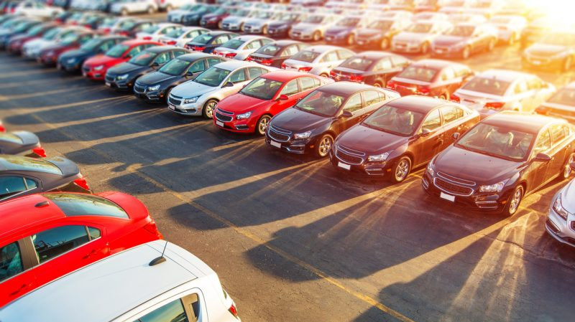
Car resale marketplace
Amolika Godse
Anuraag Gujje
Ganesh Talluri
Sai Sudheer Vishnumolakala
Suraj Shiva Kumar

Slide 2

AGENDA
Introduction – Problem statement
Talking about Dataset
Exploration Data Analysis
Data cleaning
Data preprocessing
Price Prediction : Models Fitting
Hyperparameter tuning
Results and discussion
Conclusion
Recommender System
Improvement Scope

Slide 3
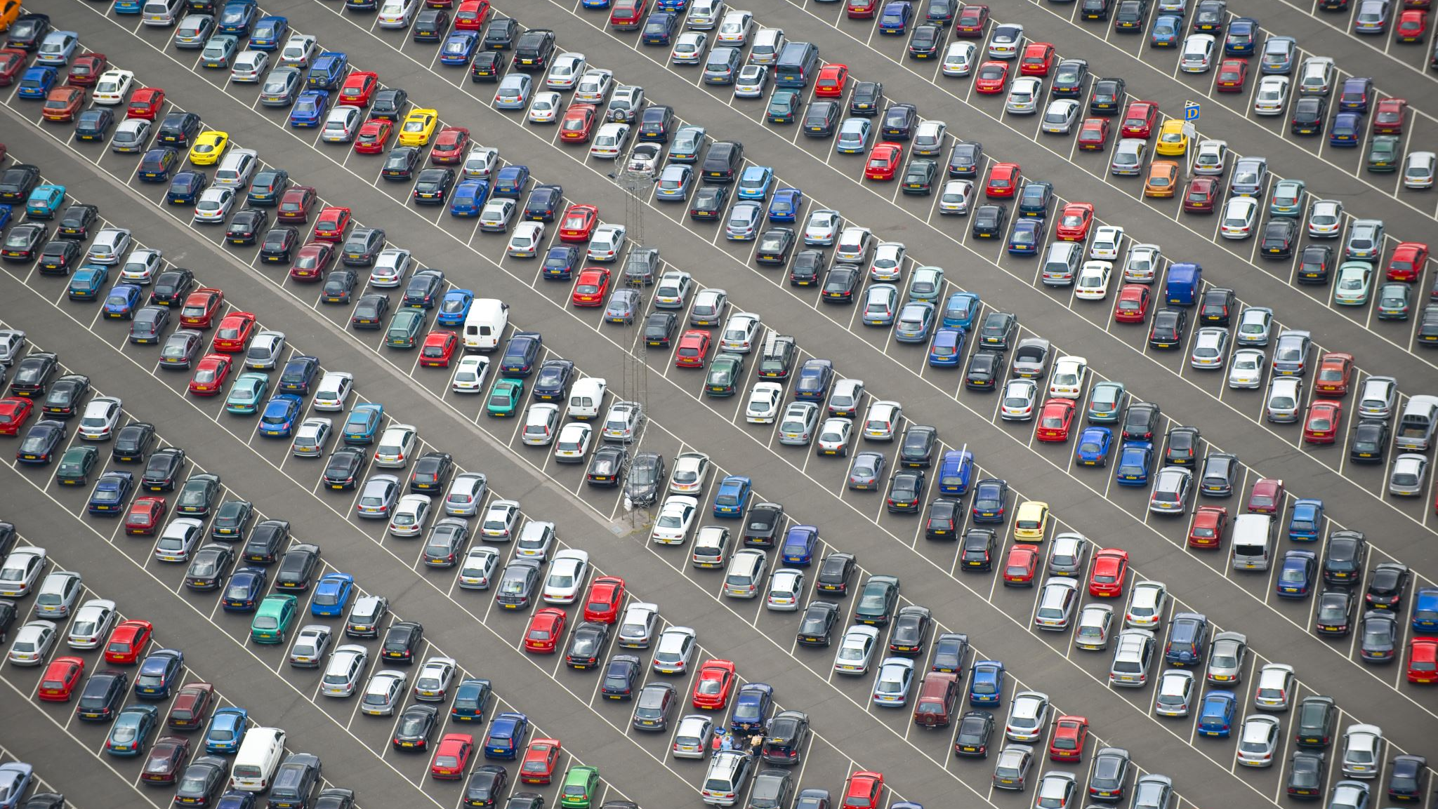
Problem Statement
Amidst a rise in car resales due to shifting preferences and economic and environmental factors, we aim to launch a data-driven car resale marketplace to simplify and enhance the buying and selling experience. Our project centers on the following key objectives:
Price Prediction Engine: Develop a sophisticated algorithm that can predict the resale price of cars with high accuracy, factoring in a comprehensive set of car features and market data to assist sellers in setting fair and competitive prices.
Smart Recommendation System: Create a recommendation engine that aligns with individual buyer preferences, such as make, model, year, mileage, and other desired features, making the search for the perfect car more efficient and personalized.

Slide 4
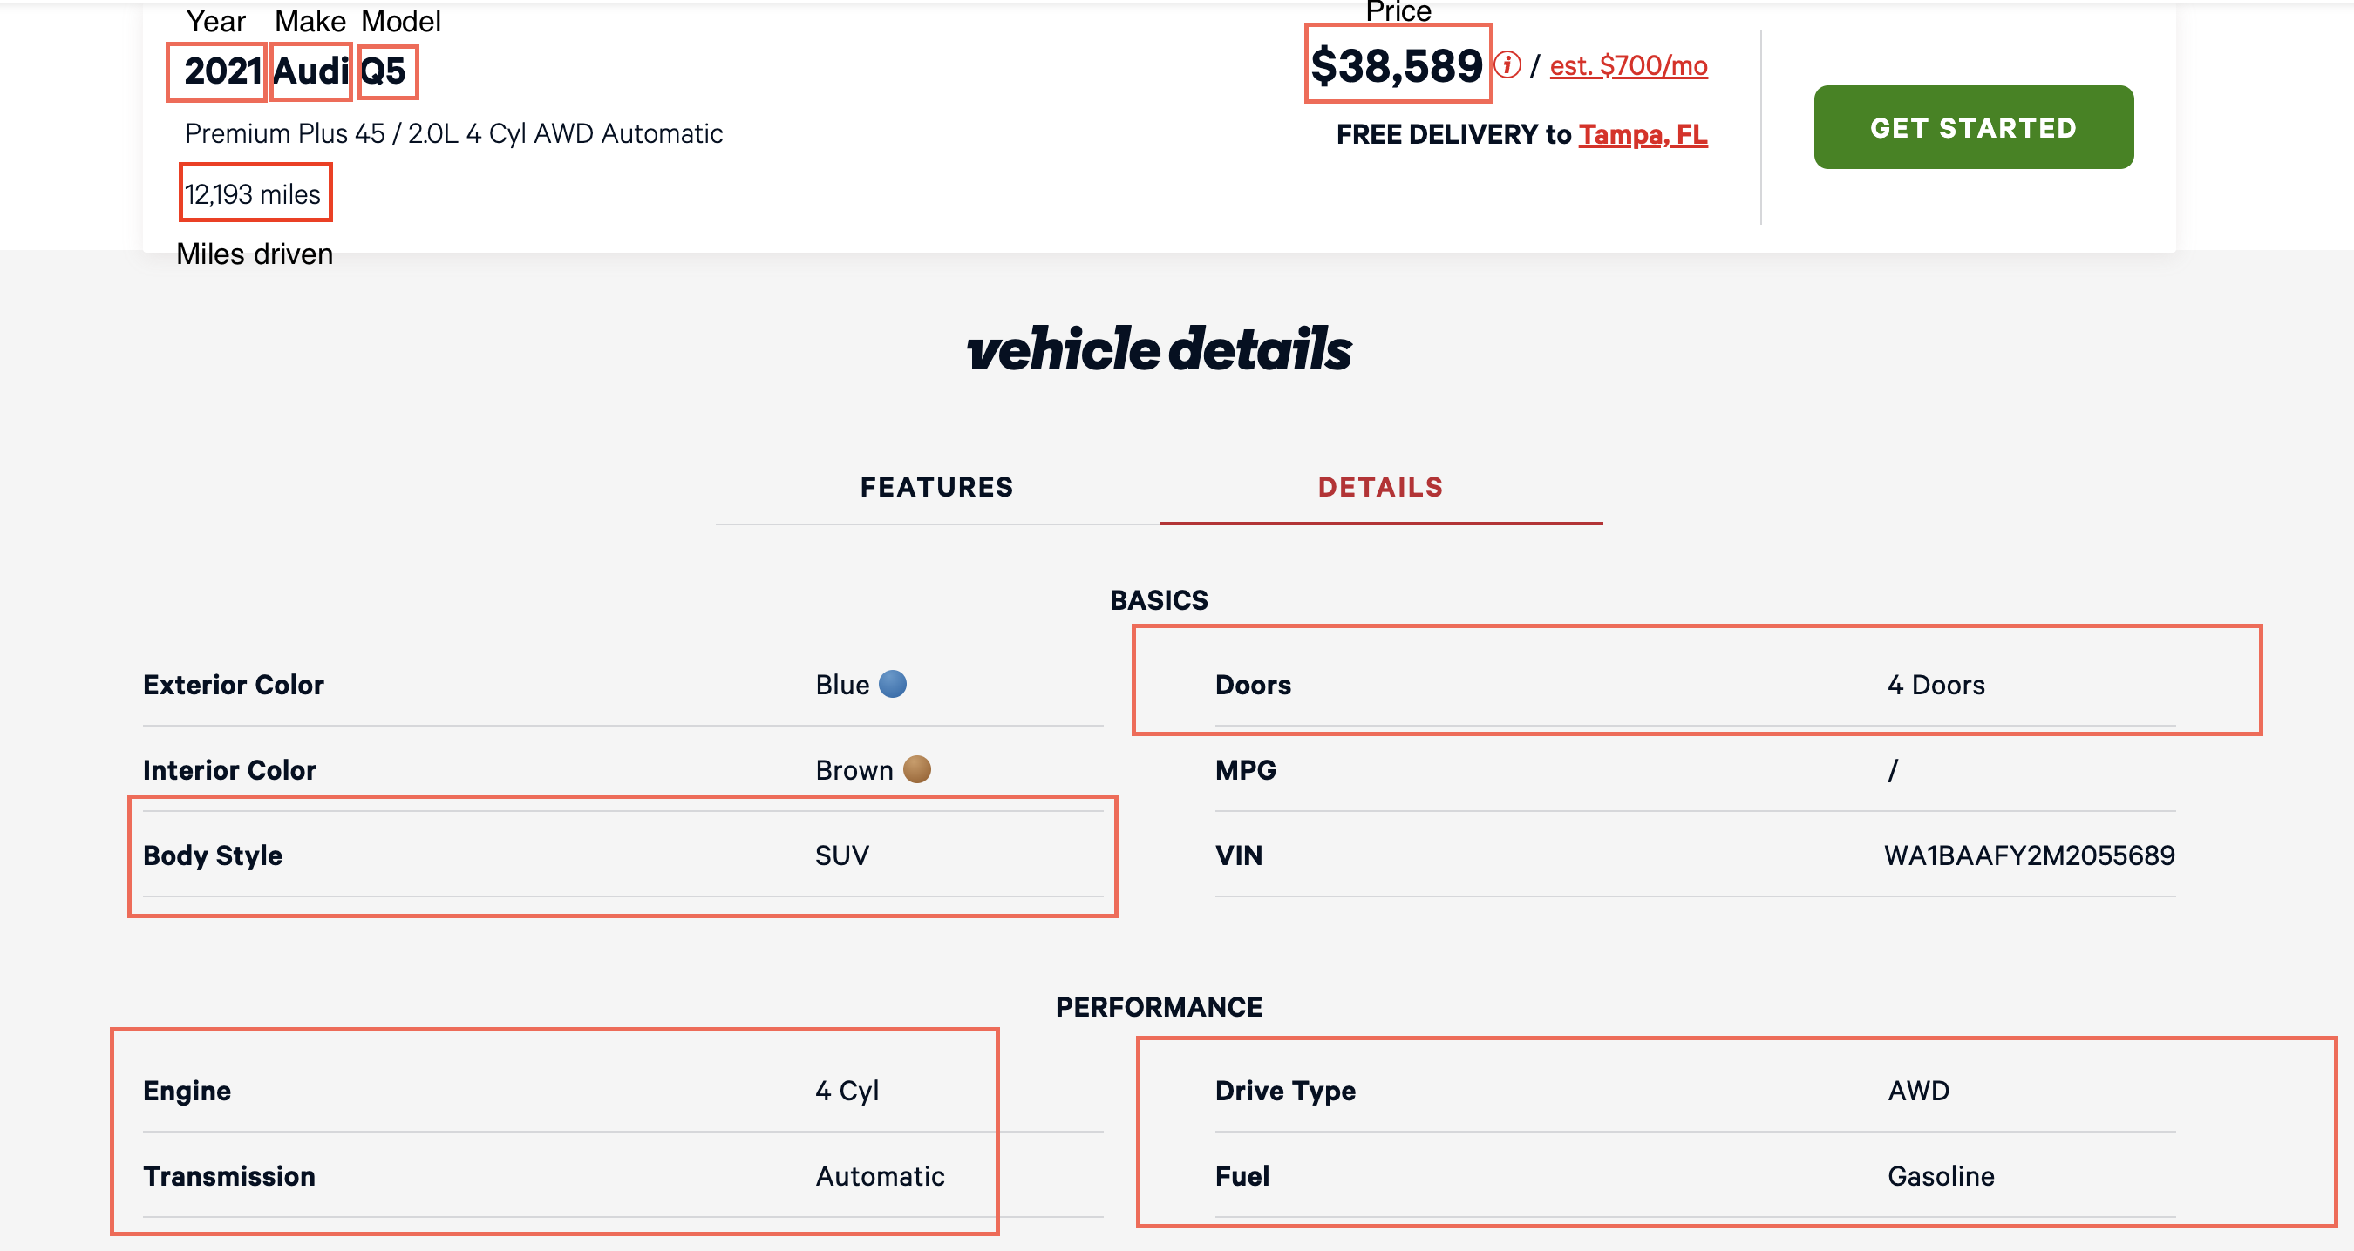
Data Extraction
We have collected data for this project by scraping car sale listings from vroom.com, a used car marketplace website, using Python libraries such as Selenium and Beautiful Soup.
This data includes comprehensive information about various car listings, which will serve as the foundation for our car resale marketplace.

Slide 5
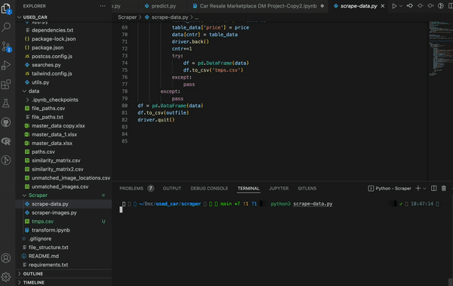
Data Extraction
The scraper
script runs on
vroom.com's
listings and extract
all relevant data
that we have targeted.

Slide 6
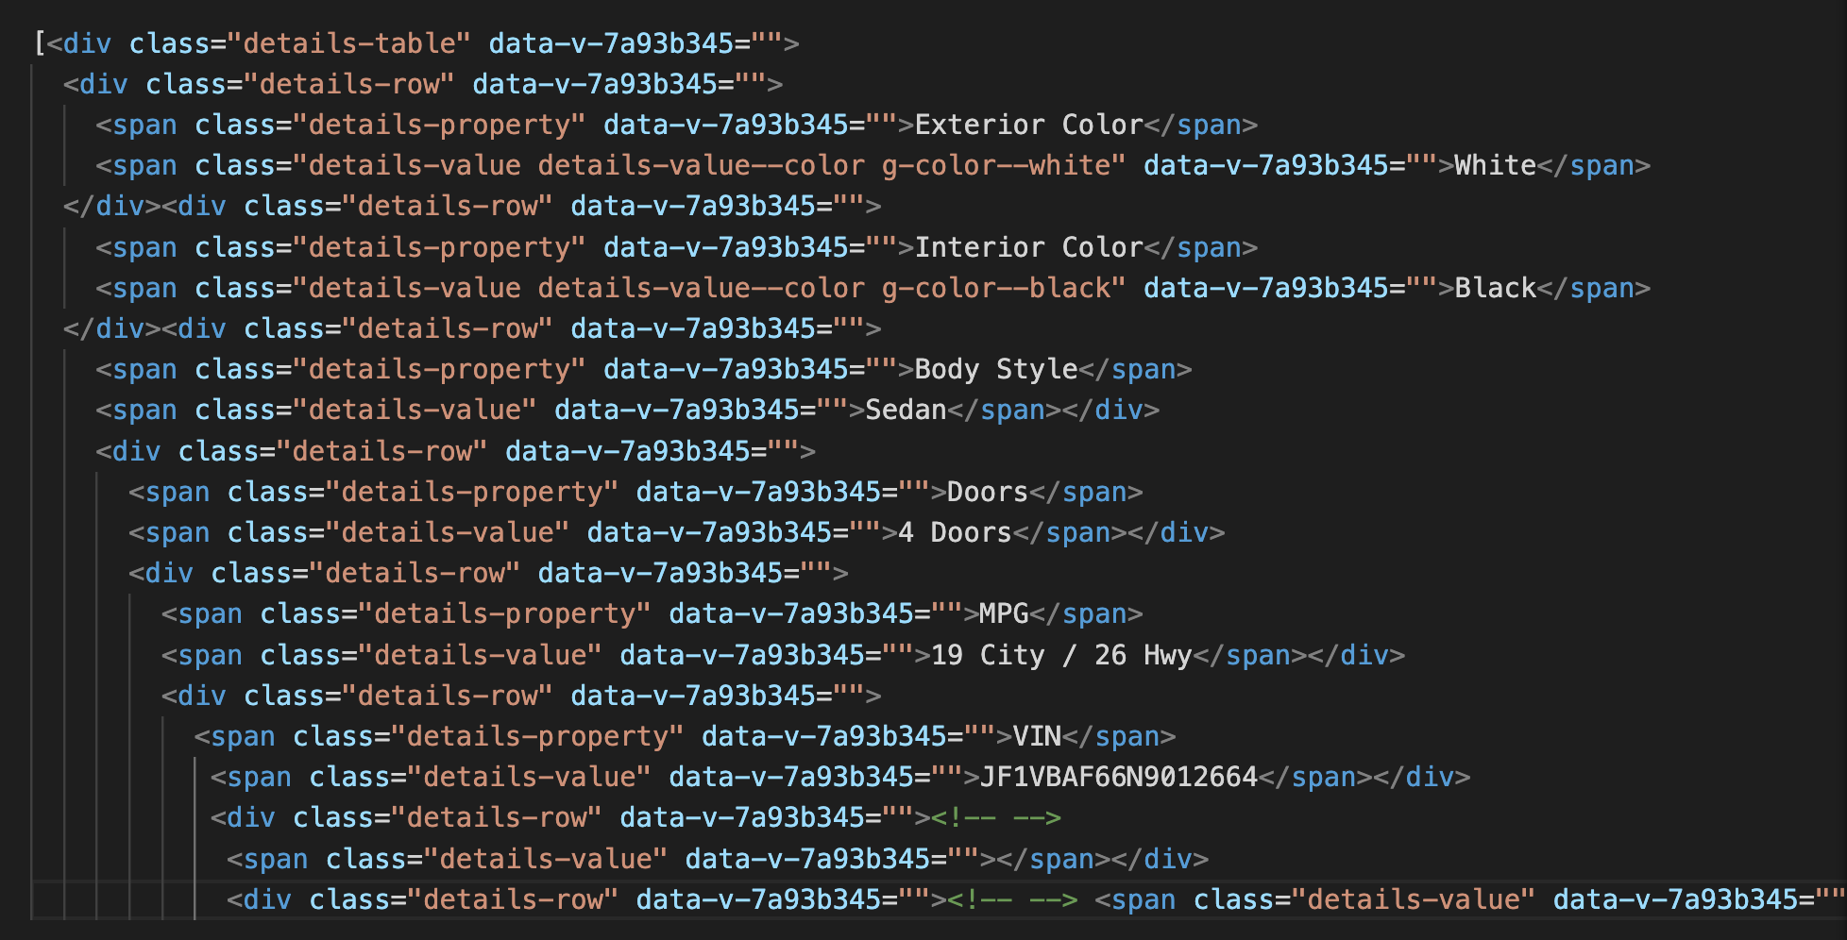
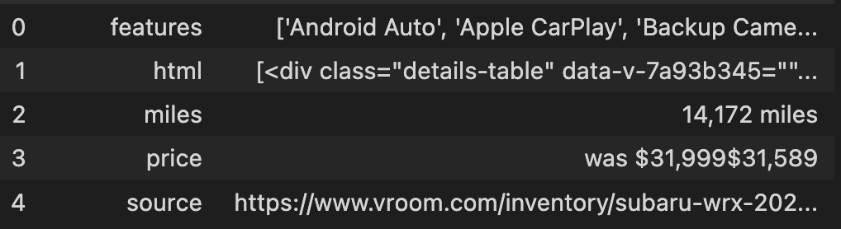
Data Extraction
Property
Value
Property
Value
Property
Value
Property
Value
Below is an example of what one vehicle's extracted scraped data looks like.
Property
Value
Property
Value
To extract the features we need we needed we wrote custom html + regex parsers to fetch the relevant information.
The idea is extracting a json from html in the form of - {"Property":"Value"}
An example is highlighted above.

Slide 7
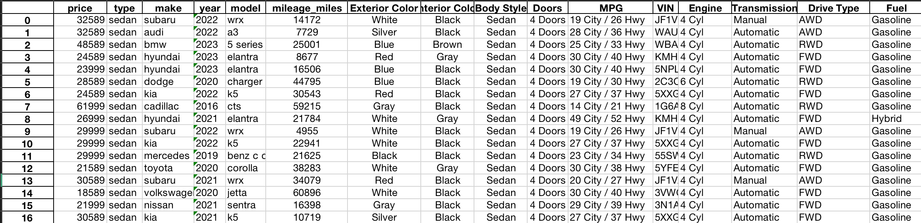
Data Extraction
After parsing, we extract and save the various features as a table(csv).
This data, although useable would need to be cleaned further and pre-processed before we can derive any insights.

Slide 8
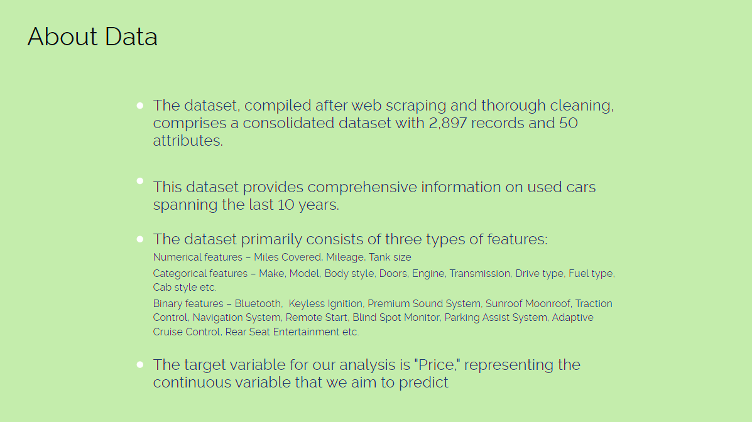

Slide 9
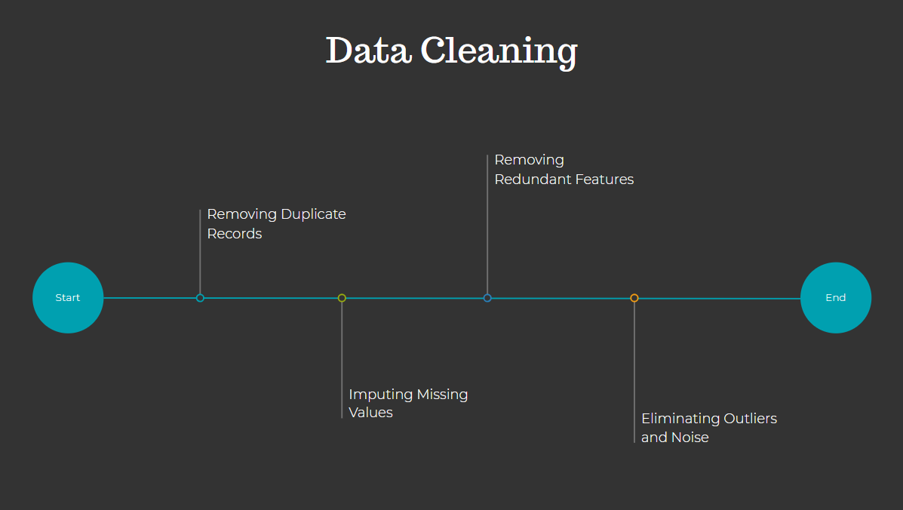

Slide 10
Data Preprocessing
Numerical Features
Standard Scaler
Categorical Features
One Hot Encoding
Ordinal Encoding
Binary Features
Passthrough (No Preprocessing)
Standard Scaling : Technique that transforms numerical features to have a mean of 0 and a standard deviation of 1, making the data comparable and suitable for various machine learning algorithms.
One Hot Encoding : Technique used to convert categorical variables into binary (0 or 1) format, creating binary columns for each category, which allows machine learning models to work with categorical data.
Ordinal Encoding : Method of converting categorical variables with ordered categories into numerical values while preserving the order or hierarchy of the categories

Slide 11
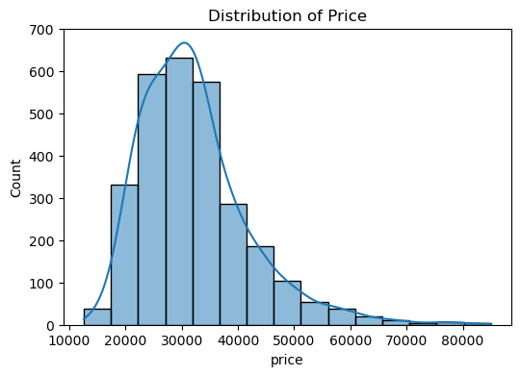
Exploratory Data analysis
Peak frequency: Between $15K - $25K
Significant drop-off after $30K
Prices rarely exceed $60K
Skewed to the right; fewer high-priced cars

Slide 12
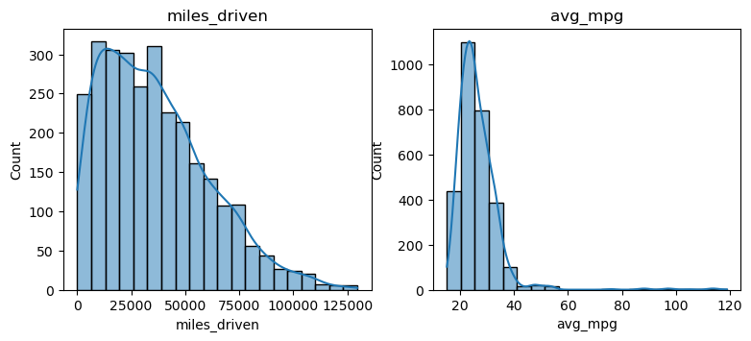
Exploratory Data analysis
​ Most cars have below 50,000 miles​​
Higher miles could imply lower prices​​
Core focus for price prediction modeling​​
Average MPG Insights:​​
Majority have MPG between 20-40​​
Fuel efficiency impacts resale value​​
Important predictor for pricing algorithm​​
Graph Analysis Summary:​​
Lower miles and higher MPG desirable​​
Data suggests strong correlation with resale value​​
Will refine pricing model for accurate predictions​​

Slide 13
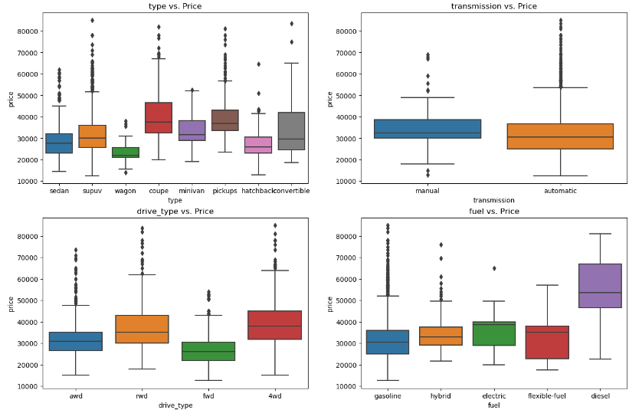
Exploratory Data
analysis
Type vs. Price:
Convertibles and pickups have higher median prices.
Sedans and hatchbacks are on the lower end of the price spectrum.
Wagons, coupes, and SUVs fall in the moderate price range.
Transmission vs. Price:
Automatic transmission cars show higher median prices than manual.
Drive Type vs. Price:
4wd vehicles display a higher median price over awd, rwd, and
fwd.
Fuel vs. Price:
Electric and diesel cars have higher median prices, indicating a premium.
Hybrid and gasoline vehicles have similar, lower median prices.
Flexible-fuel vehicles have a broad price range.

Slide 14
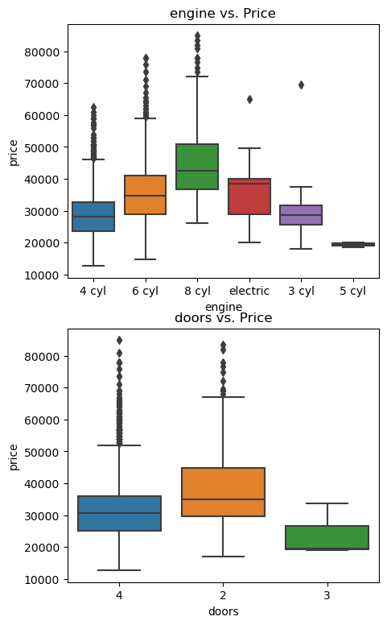
Engine vs. Price:
8 cyl engines have the highest median prices, indicating luxury or power.
6 cyl and 4 cyl engines have descending median prices respectively.
Electric engines show a varied price range, reflecting diverse technologies.
3 cyl and 5 cyl engines are rarer and have lower median prices.
Doors vs. Price:
Four-door cars tend to have higher median prices than two or three-door models.
Price Variance:
Whiskers and outliers on box plots indicate pricing variance within categories.
Variance may be due to additional features, brand value, or unrepresented market factors.

Slide 15
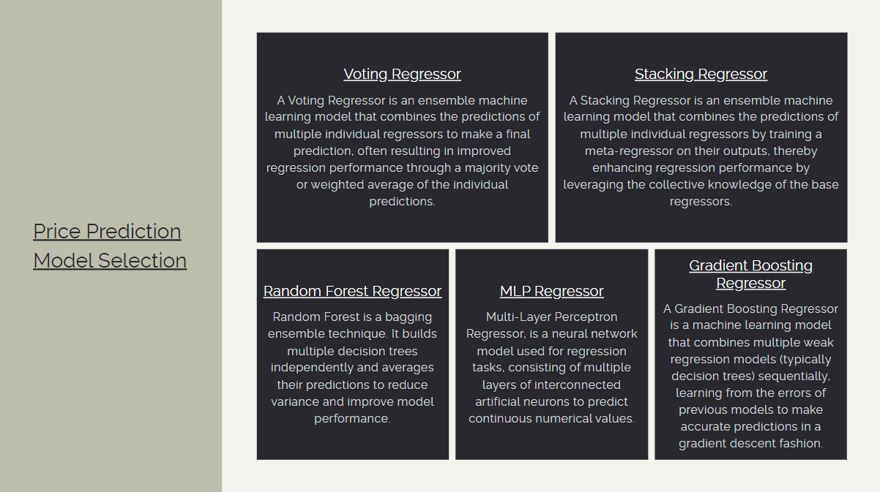

Slide 16

Hyper Parameter Tuning
Used Hyperopt Bayesian optimization for efficient hyperparameter search across large spaces.
The "search space" defines the range and distribution of values that Hyperopt will explore for each hyperparameter.
Better than grid and random search.

Slide 17
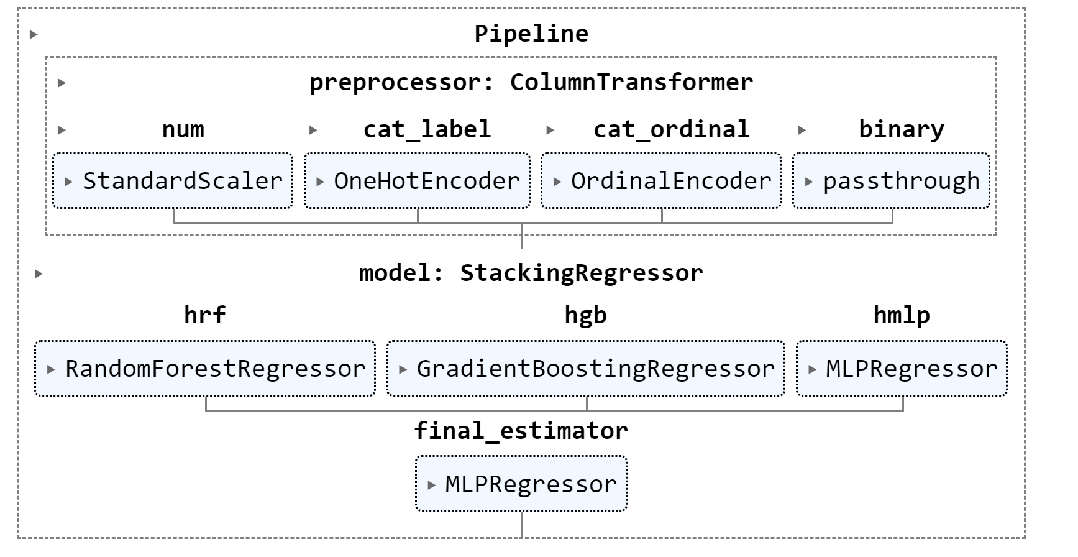
PRICE PREDICTION BEST MODEL PIPELINE – STACKING REGRESSOR

Slide 18
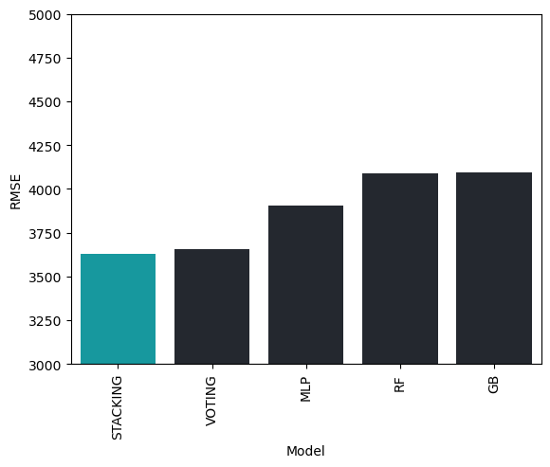
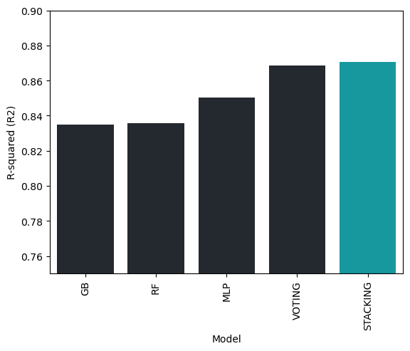
RESULTS & comparison
Model | RMSE | R-squared (R2)
RF | 4089.877832 | 0.835611
MLP | 3904.654957 | 0.850163
GB | 4096.817156 | 0.835052
VOTING | 3657.532535 | 0.868529
STACKING | 3629.310228 | 0.87055

Slide 19
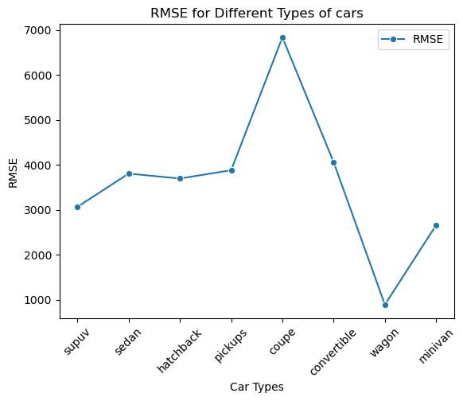
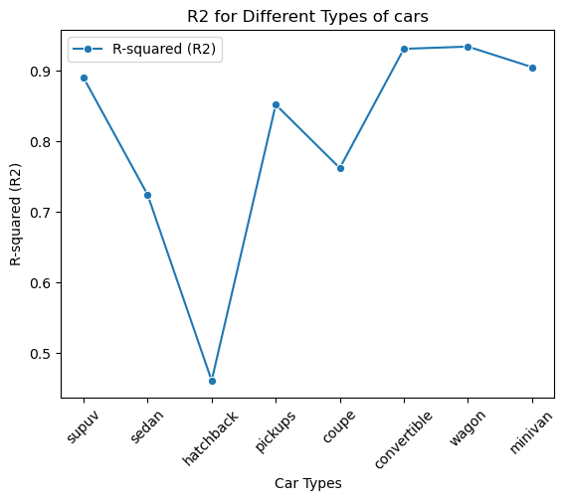
Comparison between different car types using stacking MODEL
Car Type | RMSE | R-squared (R2)
supuv | 3063.426467 | 0.88999
sedan | 3803.622227 | 0.724137
hatchback | 3693.666955 | 0.460558
pickups | 3878.675135 | 0.851742
coupe | 6834.910833 | 0.761868
convertible | 4056.825989 | 0.930856
wagon | 889.118832 | 0.934024
minivan | 2657.640372 | 0.904921

Slide 20
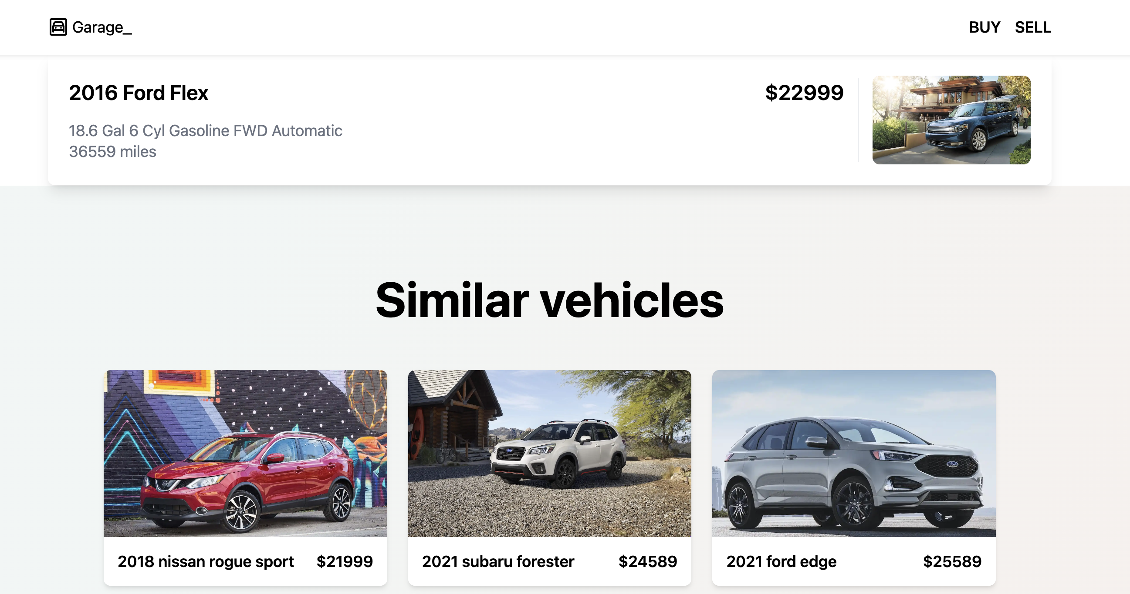
Recommender System
Objective: Suggest related items related to the product the user is currently examining.
Target/active item This is the item that a user is currently viewing.
Recommended Item(s)
The items/products being shown based on the active item.

Slide 21
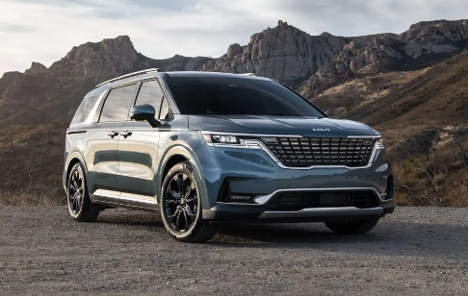
Recommender System
Given that the goal is to recommend similar cars, we should apply item-item collaborative filtering as our preferred method.
The main idea behind item-item collaborative filtering is to recommend items to a user based on the user's past interactions and the similarities between the items themselves.
Every Item can be thought of as a vector based on the features it has.
Mileage
Price
Doors
Tank Size
Body Type
15,000$ 20,000 4 SUV 18.9

Slide 22

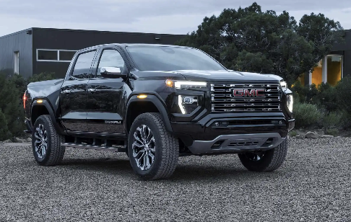
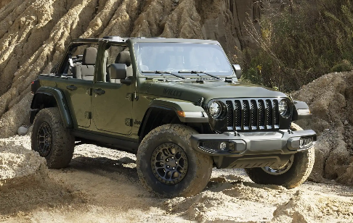

RECOMMENDER SYSTEM
⍬a < ⍬b​ < ⍬c < ⍬d
Therefore, Car a will be most similar
Car d will be least similar
Since similarity ∝ 1/⍬
⍬d
⍬c
⍬b
⍬a

Slide 23
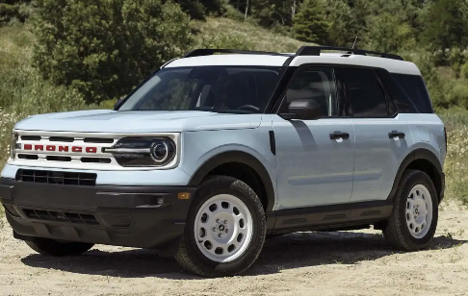
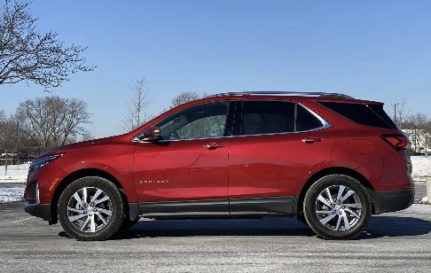
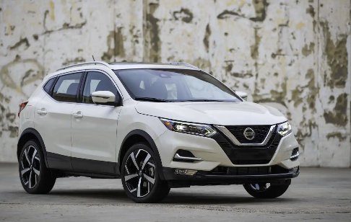

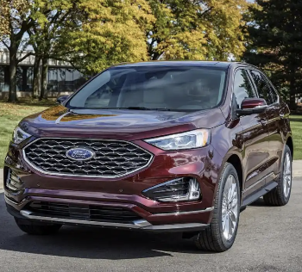
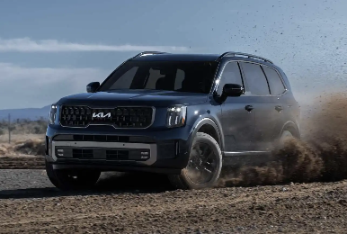
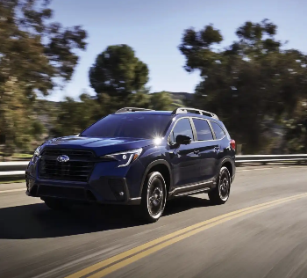
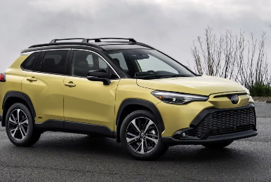
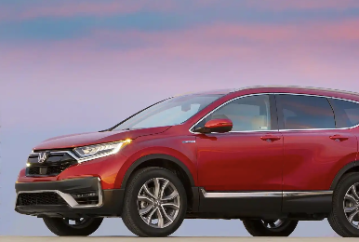
Recommender System
Given the data set we initially form natural clusters based on car type.
Within car types we create a nxn matrix with similarity scores for each car against the other.
Finally, we pick out top M cars to recommend.
0. 1. 2. n
0 1 M
0
1
2
n
1 | 0.95 | 0.05
0.95 | 1 | 0.6
0.05 | 0.6 | 1
0.01
0.04
0.22
1
0
1
N-1
N
0.01 | 0.4 | 0.22

Slide 24











Implementation
Frontend
Database
Web scraping
Backend

Slide 25

Improvement Scope
Incorporate Real-time Data: Constantly update the algorithm with real-time data from various sources to reflect the most current market conditions.
Market Insights: Offer market trend analysis to sellers, giving them insights into when might be the best time to sell.
Buyer-Seller Matching: Use the system to not just recommend cars but also match sellers with potential buyers, creating a more efficient marketplace.
Interactive Experience: Develop an interactive interface that visually adapts as buyers specify preferences, perhaps using virtual reality or augmented reality for car viewing.

Slide 26

Thank you

Slide 27


